Slide 1
Cross Skill

Slide 2
Target
Creating Crud API’s with PostGreSql using Prisma Orm and NestJS

Slide 3
Content
Connection setup
Environment
User Model
Create
Retrieve
Update
Delete

Slide 4
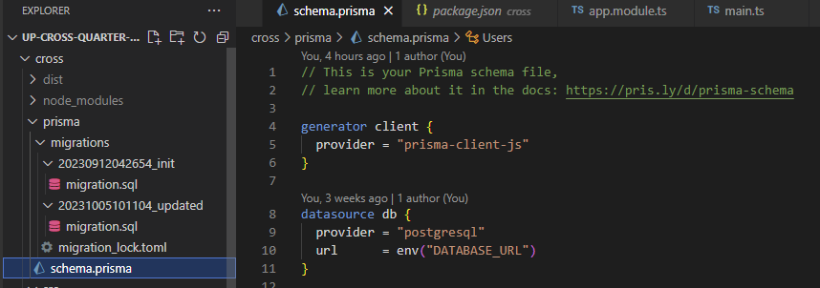
Connection Setup With Prisma
Add prisma and prisma client with the following command::
Then initiate prisma with the following:
After the command a folder is created named “prisma” and inside it there’s a file, schema.prisma

Slide 5
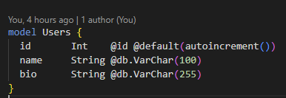
Environment
Add database url in the .env file:
Add the model in the schema.prisma file:

Slide 6
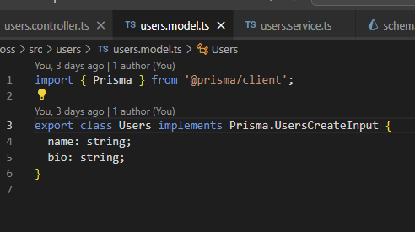
Model

Slide 7
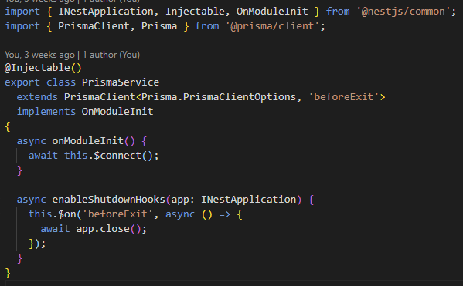
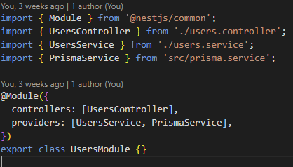
Prisma service and User module
Prisma service:
User module:

Slide 8
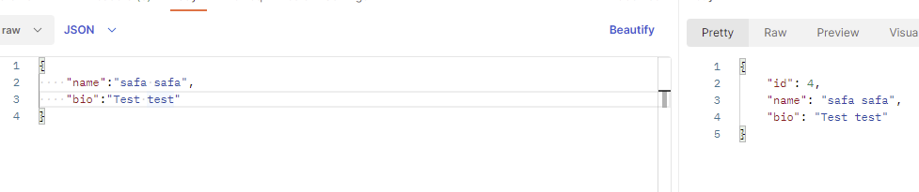
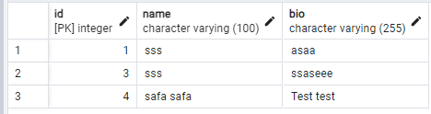
Create

Slide 9
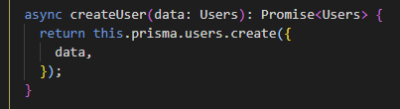

Create (Contd.)

Slide 10

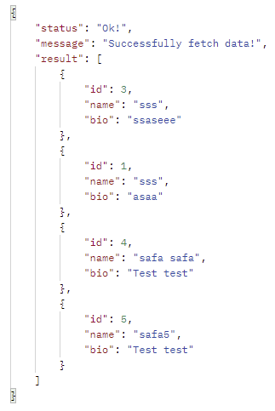
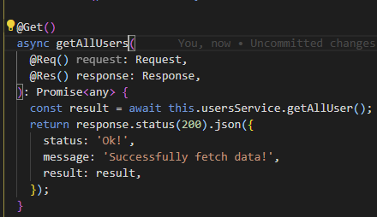
Retrieve (All)
User.service:
Users.controller:
Result:

Slide 11




Retrieve Single element
User.service:
User.controller:
URL:
Result:

Slide 12
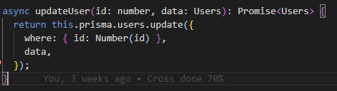


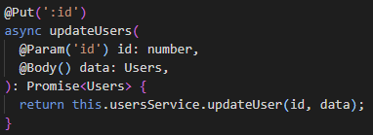
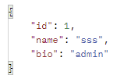
Update
User.service:
User.controller:
URL:
Body:
Result:

Slide 13
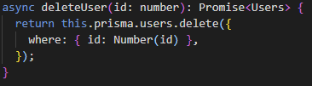


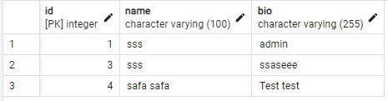
Delete
User.service:
User.controller:
Url:
Result:

Slide 14
Up Skill
Session: July- September, 2023
Md. Rashedul Hasan Safa
10482

Slide 15
Target
Basic of React-redux with redux/toolkit

Slide 16
What was done?
Basic Page setup
Store setup
Create a postSlice file
Create
Retrieve
Update
Delete

Slide 17
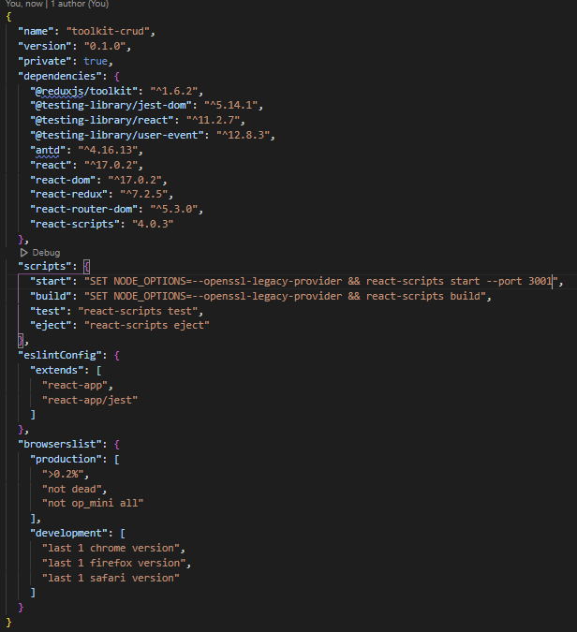
Basic setup
First run the cross app
Downloaded skeleton code from:
https://github.com/trickjsprogram/toolkit-crud-api
The package.json:

Slide 18
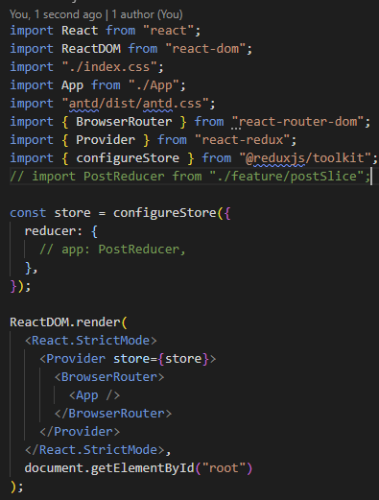
Setup store

Slide 19
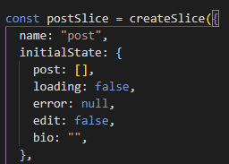
Create a postSlice

Slide 20
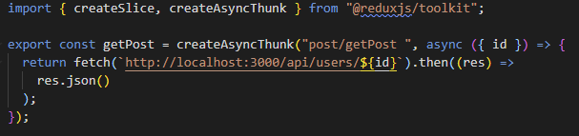
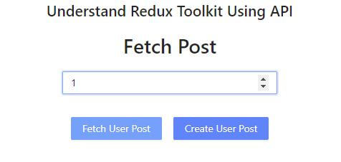
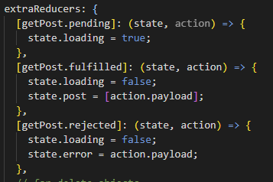

Retrieve

Slide 21
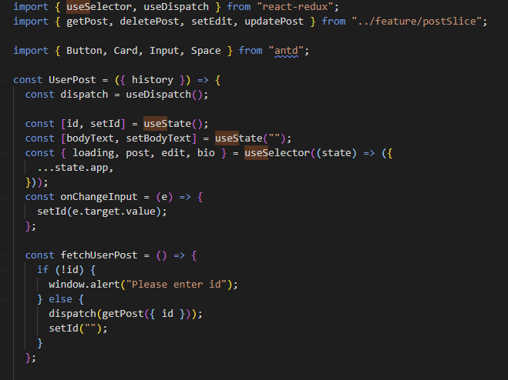
Retrieve (Contd.)

Slide 22
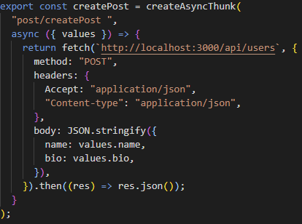
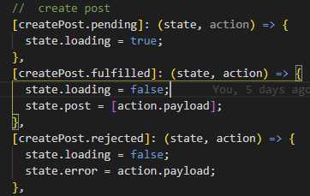
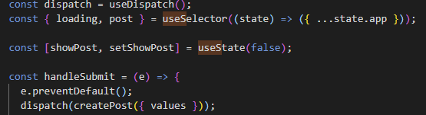
Create
In PostSlice:

Slide 23
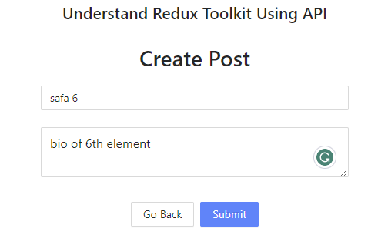
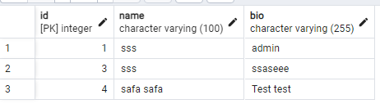
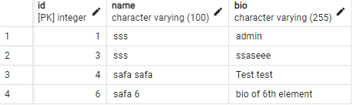
Create (Contd.)
The UI:
Table before submission:
Table after submission:

Slide 24
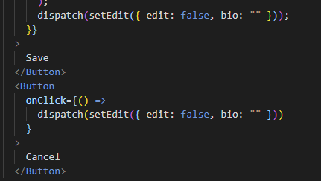
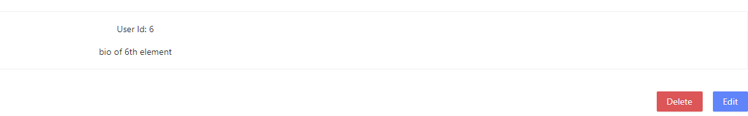
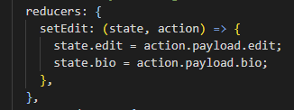
Update

Slide 25
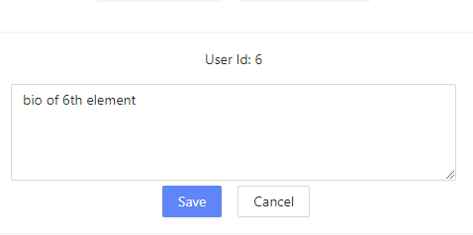
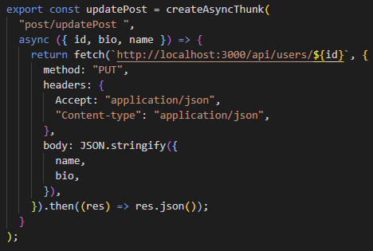
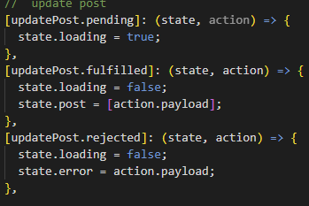
Update(Contd.)
After Clicking edit

Slide 26
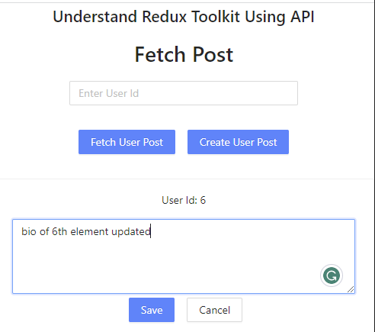
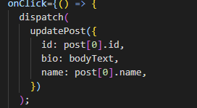
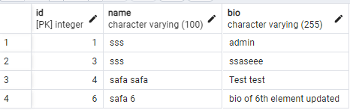
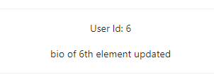
Update (Contd.)

Slide 27
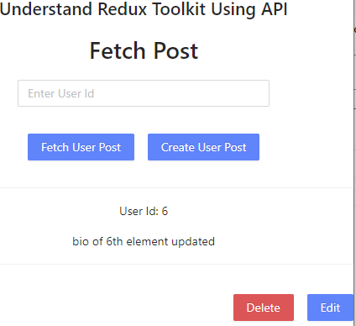
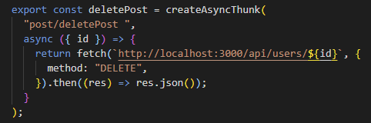
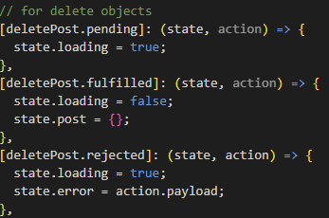
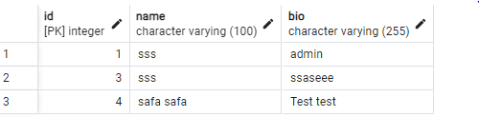
Delete

Slide 28


